Slide 1

Basic Details of the Team and Problem Statement
Ministry/Organization Name/Student Innovation:
Ministry of Defence
PS Code: SIH1418 Problem Statement Title:
Deep learning for terrain recognition
Team Name: GrowGuards Team Leader Name: Uzzma Saiyed Institute Code (AISHE): C-58356 Institute Name:
Faculty of Computer Applications and IT
Theme Name: Miscellaneous

Slide 2























Idea/Approach Details
IDEA DESCRIPTION:
Presenting app base solution that uses AI to instantly identify and assess terrain types, roughness, and slipperiness. It is a valuable tool for outdoor adventures, military operations, and environmental monitoring, empowering users with critical terrain insights for safer and more informed decision-making.
PROCESS FLOW CHART
Image Analysis
Launch Application
Image Processing
Select Mode
Feature Extraction
Terrain Identification
Capture Image
Sandy, Rocky, Grassy, Marshy, etc..
Terrain Assessment
Terrain Classification
TECHNOLOGY STACK
Capture Image
Image Analysis
Confidence Score
Image Processing
Front-End
Tech Stack
Middleware
Tech Stack
Back-End
Tech Stack
Database
Servers
Roughness Estimation
High, Medium, Low
Display Result
Slipperiness Estimation
Low, Moderate, High
Flutter
Rest API
Python
Firebase+ MySQL
Apache
Visual Representation
Exit

Slide 3
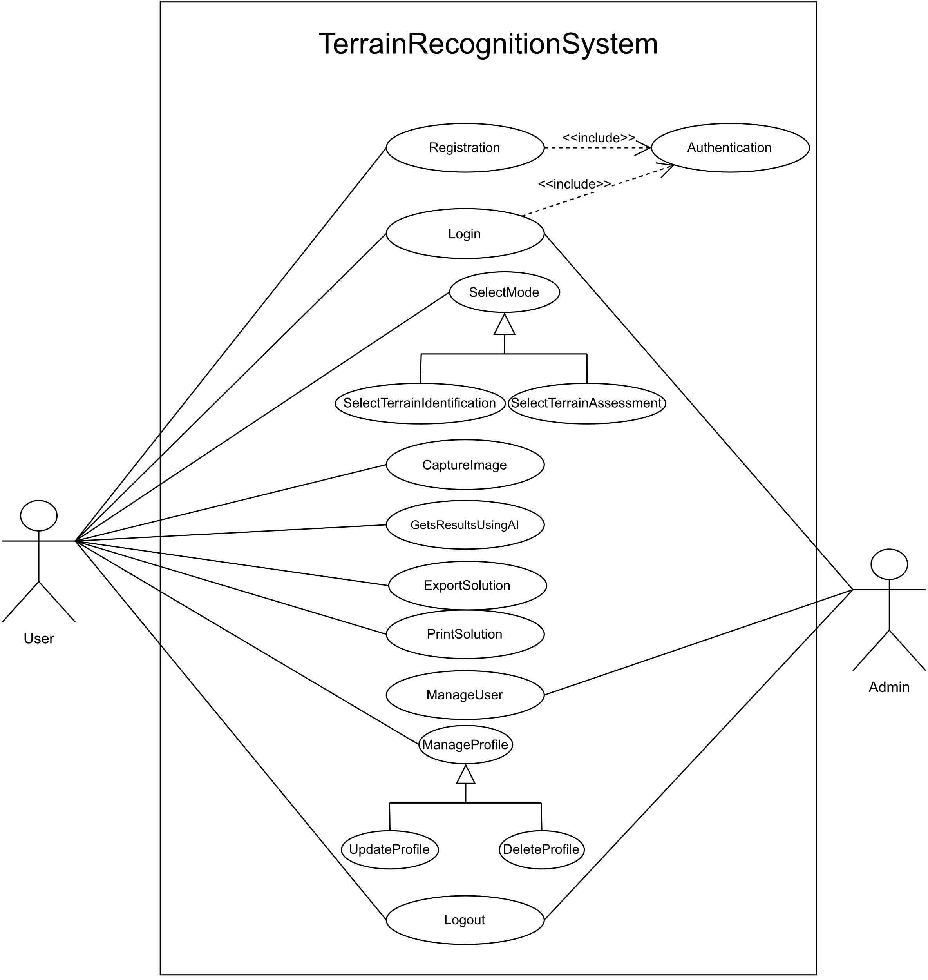




Idea/Approach Details
Use Case
SHOW STOPPER
Dependencies
Difficulty in measuring implicit quantities data, such as roughness and slipperiness.
The need to develop a user-friendly and efficient mobile app interface.
The need to optimize the deep learning model for performance on mobile devices.
The need to ensure the accuracy and reliability of the terrain recognition system.
A large and comprehensive dataset of images and implicit quantities data for different types of terrain.
Access to computing resources for training and deploying the deep learning model.
Expertise in deep learning and mobile app development.
Display Result
Results
Export Solution
Print Solution
Results
Happy User

Slide 4
Team Member Details
Team Leader Name: UZZMA SAIYED
Msc. Stream (ECE, CSE etc): Year (I,II,III,IV): I
Team Member 1 Name: SMIT JOSHI
Msc. Stream (ECE, CSE etc): Year (I,II,III,IV): I
Team Member 2 Name: TEJASV MODI
Msc. Stream (ECE, CSE etc): Year (I,II,III,IV): I.
Team Member 3 Name: KHUSHI LODHA
Msc. Stream (ECE, CSE etc): Year (I,II,III,IV): I
Team Member 4 Name: DIGVIJAY JAKHANIYA
Msc. Stream (ECE, CSE etc): Year (I,II,III,IV): I
Team Member 5 Name: VISHVA RAVAL
Msc. Stream (ECE, CSE etc): Year (I,II,III,IV): I
Team Mentor 1 Name: PROF. RACHANA CHAUDHARI
Category : Academic Expertise: Web and Mobile Development Domain Experience (in years): 9

